Slide 1
Programming Fundamentals 1

Slide 2
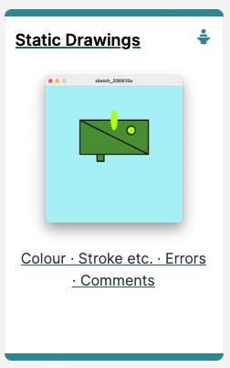
Introduction to Processing
Static Drawings, Colour and more

Slide 3
Agenda
Static Drawing
Colour & Filling Shapes
Formatting Shape Outline
Syntax and Logic Errors
Comments

Slide 4
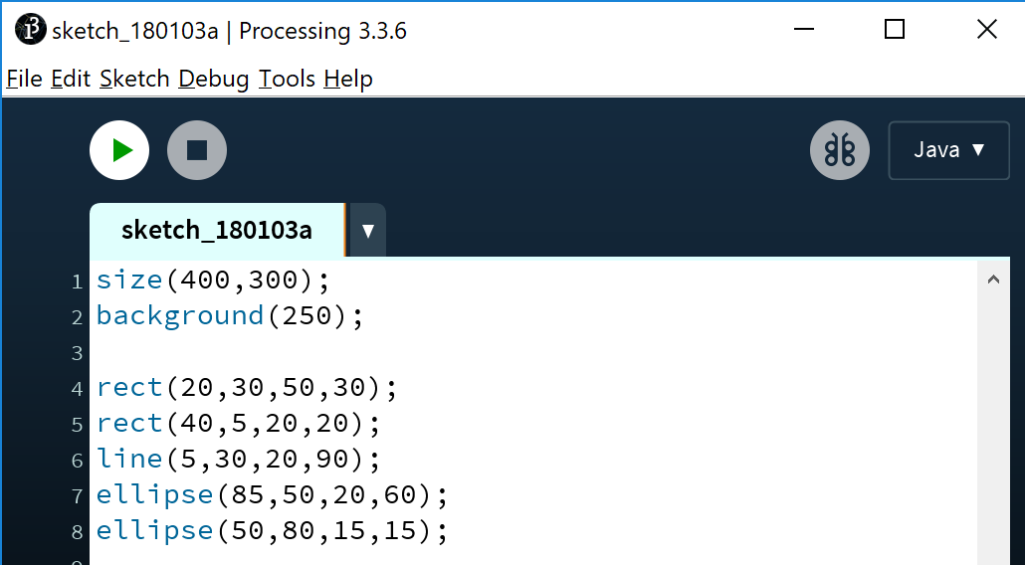
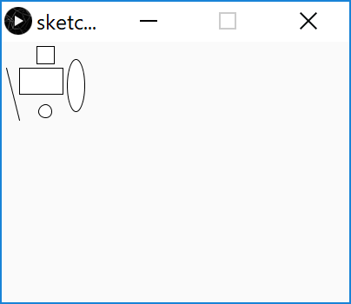
Static drawing – an example
Notes:
size(400,300);
background(250);
rect(20,30,50,30);
rect(40,5,20,20);
line(5,30,20,90);
ellipse(85,50,20,60);
ellipse(50,80,15,15);

Slide 5
Static drawing – an example
Static drawings are those that don’t change over time:
Once they are drawn, they don’t change.
They don’t respond to events e.g. a mouse moving over the sketch, a key being pressed, etc.
Notes:
size(400,300);
background(250);
rect(20,30,50,30);
rect(40,5,20,20);
line(5,30,20,90);
ellipse(85,50,20,60);
ellipse(50,80,15,15);

Slide 6

Colour (Grayscale and RGB)

Slide 7
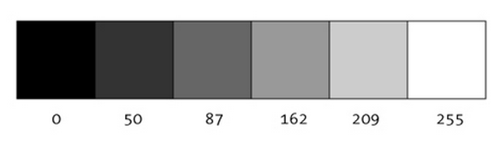
We looked at the Grayscale palette
“0 means black, 255 means white. In between, every other number - 50, 87, 162, 209, and so on - is a shade of gray ranging from black to white.”
https://www.processing.org/tutorials/color/

Slide 8
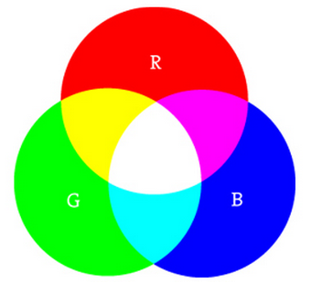
The RGB palette
“As with grayscale, the individual color elements are expressed as ranges from 0 (none of that color) to 255 (as much as possible), and they are listed in the order R, G, and B.”
Digital colours are made by mixing the three primary colours of light (red, green, and blue).

Slide 9
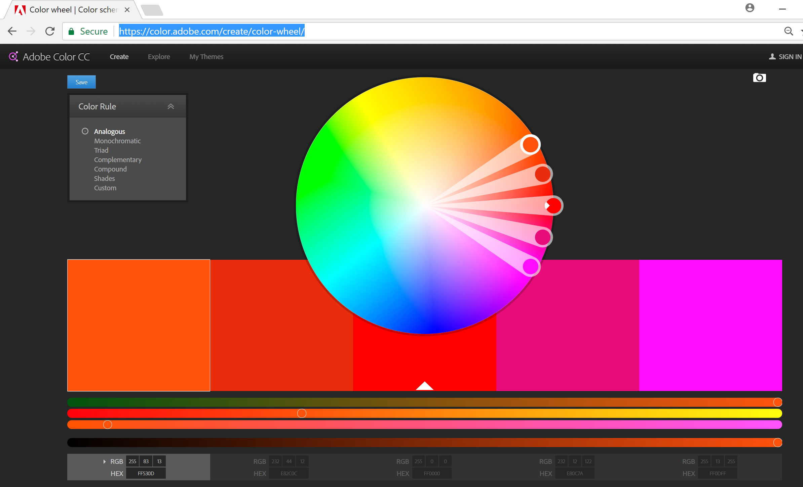
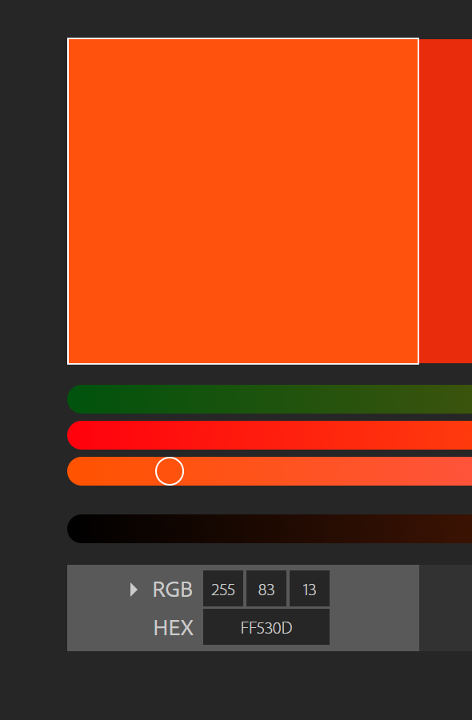
https://color.adobe.com/create/color-wheel/

Slide 10
background() - syntax
background(grayscale)
grayscale = grayscale colour (a number between 0 [black] and 255 [white] inclusive)
background(r, g, b)
r = red colour (a number between 0 and 255 inclusive)
g = green colour (a number between 0 and 255 inclusive)
b = blue colour (a number between 0 and 255 inclusive)
Notes:
The background method is “overloaded” i.e. same method name but different parameter lists. More on this in later lectures.

Slide 11
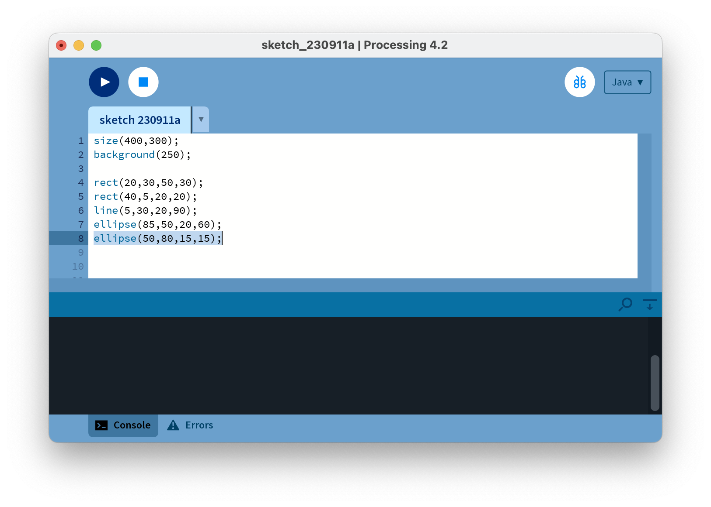
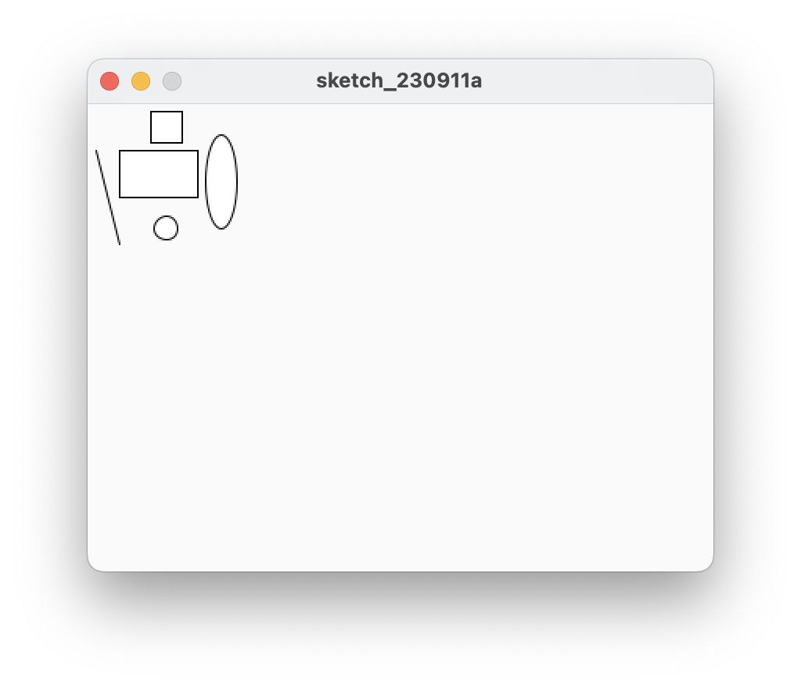
background() - grayscale
Notes:
size(400,300);
background(250);
rect(20,30,50,30);
rect(40,5,20,20);
line(5,30,20,90);
ellipse(85,50,20,60);
ellipse(50,80,15,15);

Slide 12

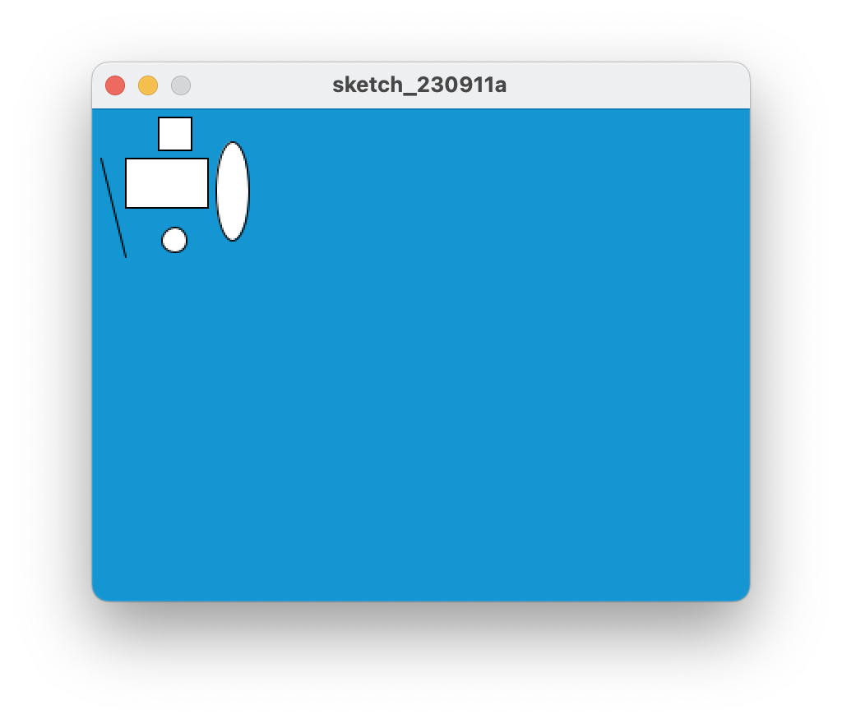
background() – R,G,B
Notes:
size(400,300);
background(250);
rect(20,30,50,30);
rect(40,5,20,20);
line(5,30,20,90);
ellipse(85,50,20,60);
ellipse(50,80,15,15);

Slide 13

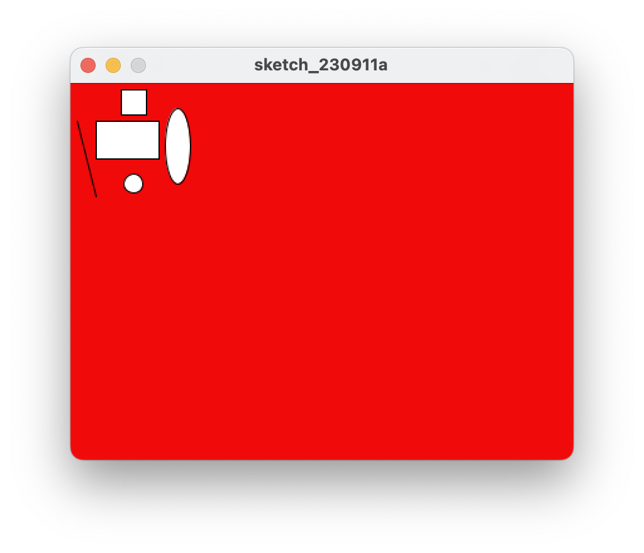
background() – R,G,B
Notes:
size(400,300);
background(250);
rect(20,30,50,30);
rect(40,5,20,20);
line(5,30,20,90);
ellipse(85,50,20,60);
ellipse(50,80,15,15);

Slide 14
Filling Shapes with Colour

Slide 15
fill() - syntax
fills shapes with a chosen colour.
can use the RGB colours to select a colour.
all shapes drawn after the fill function is called, will be filled with the chosen colour.
fill (r, g, b)
r = red colour (a number between 0 and 255 inclusive)
g = green colour (a number between 0 and 255 inclusive)
b = blue colour (a number between 0 and 255 inclusive)

Slide 16
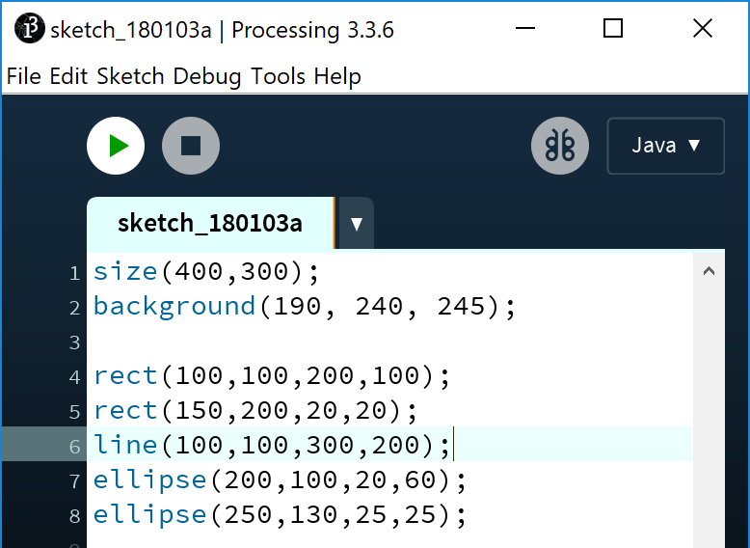
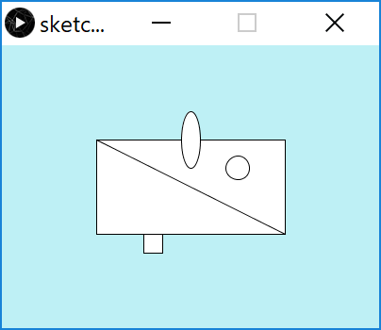
fill()
Before using fill(), all shapes fill with default of white.
Notes:
size(400,300);
background(190, 240, 245);
rect(100,100,200,100);
rect(150,200,20,20);
line(100,100,300,200);
ellipse(200,100,20,60);
ellipse(250,130,25,25);

Slide 17
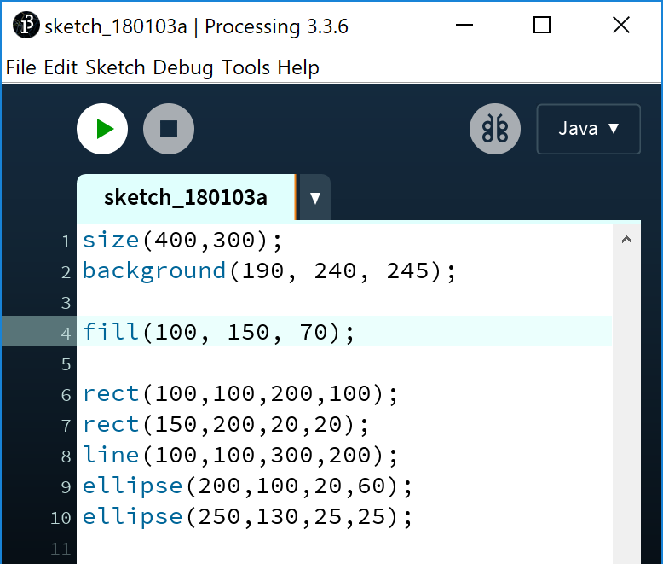
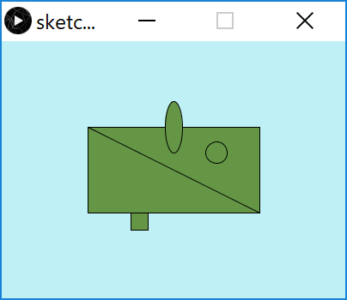
fill()
Now all shapes are filled with dark green.
Notes:
Draw attention to how the sequence of statements matter.
size(400,300);
background(190, 240, 245);
fill(100, 150, 70);
rect(100,100,200,100);
rect(150,200,20,20);
line(100,100,300,200);
ellipse(200,100,20,60);
ellipse(250,130,25,25);

Slide 18
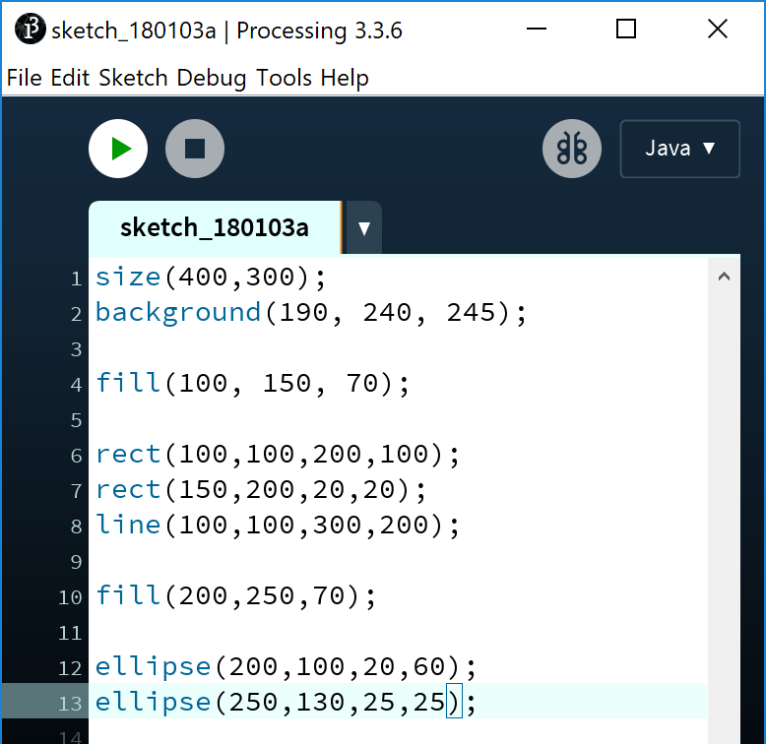
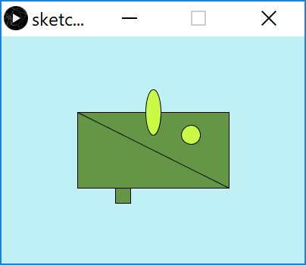
fill()
Rectangles filled with dark green. Ellipses filled with light green; order of statements matter!!!
Notes:
size(400,300);
background(190, 240, 245);
fill(100, 150, 70);
rect(100,100,200,100);
rect(150,200,20,20);
line(100,100,300,200);
fill(200,250,70);
ellipse(200,100,20,60);
ellipse(250,130,25,25);

Slide 19
Formatting the Shape Outline

Slide 20
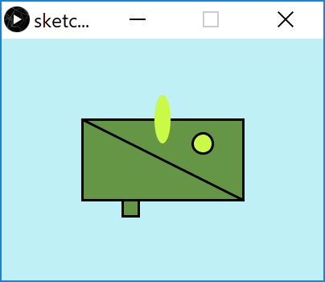
Changing the outline (i.e. stroke)
Before
After (changes):
The oval has no border; all other shapes do.
The outline is heavier.
We will now make those changes

Slide 21
noStroke() - syntax
A stroke is the outline of a shape.
The noStroke() function disables the outline on shapes that are drawn after the function is called.
All shapes drawn after the noStroke function is called, will have no outline.
noStroke();
//no parameters defined for this function.

Slide 22
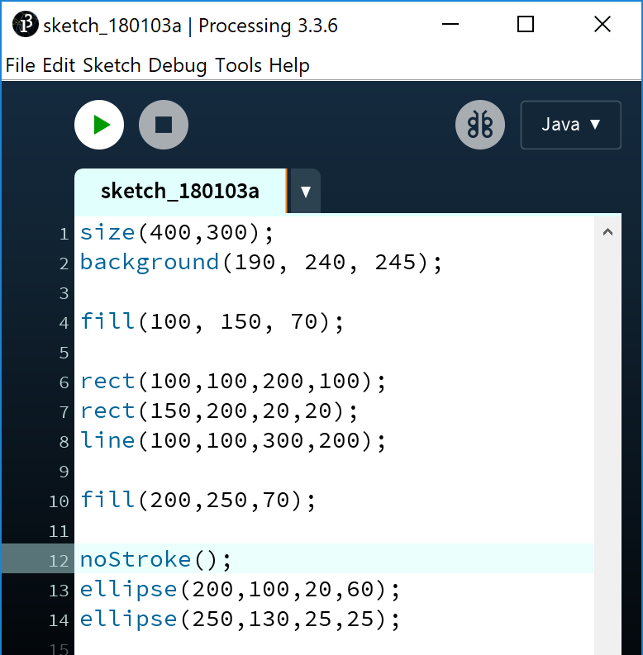
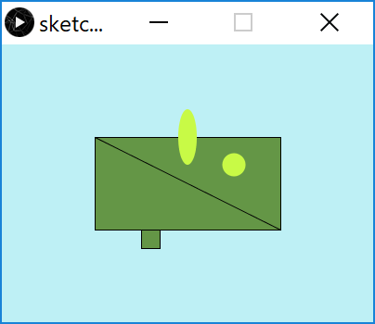
noStroke()
√ We have no border on the oval shape.
X But now our circle also has no border.

Slide 23
stroke() - syntax
The stroke() function enables the outline on all shapes that are drawn after the function is called.
When you call stroke(), you need to specify a colour.
stroke (r, g, b)
r = red colour (a number between 0 and 255 inclusive)
g = green colour (a number between 0 and 255 inclusive)
b = blue colour (a number between 0 and 255 inclusive)

Slide 24
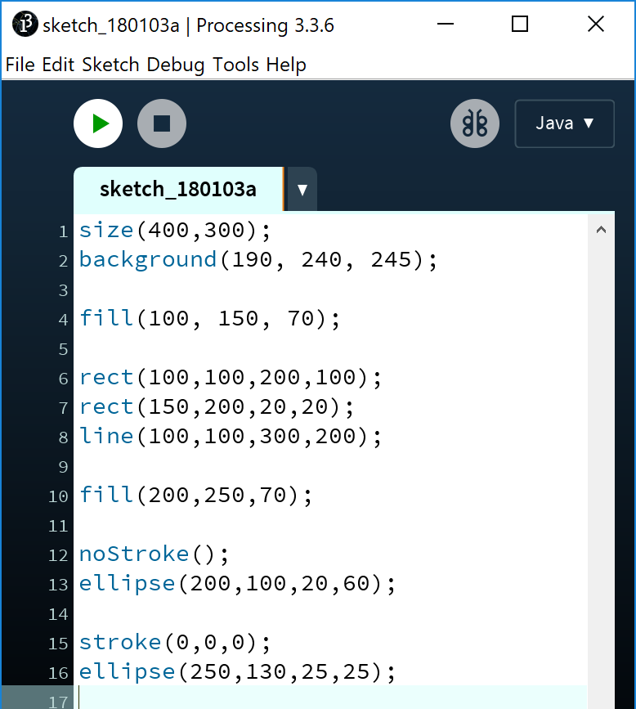
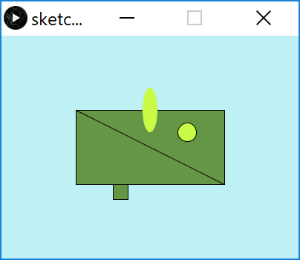
stroke()
√ Our circle now has a border.

Slide 25
strokeWeight() - syntax
The strokeWeight() function allows you to choose the thickness of a line/outline on shapes.
The chosen thickness will apply to all lines/shapes that are drawn after the function is called.
The thickness is specified in pixels.
The default thickness is 1 pixel.
strokeWeight (pixels)
pixels = thickness of the outline measures in pixels.

Slide 26
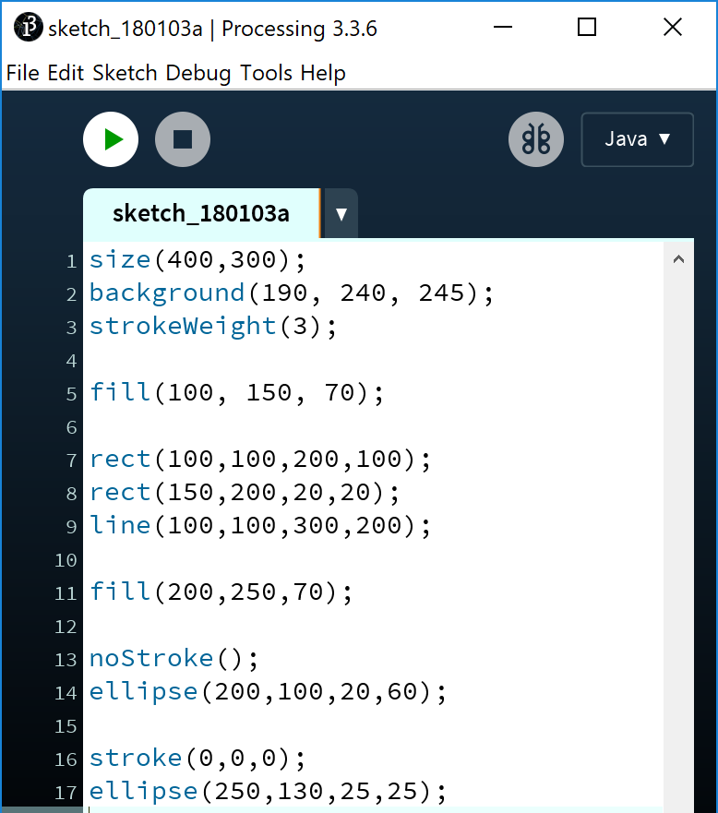
strokeWeight()
√ Our outline is now heavier.
Notes:
size(400,300);
background(190, 240, 245);
strokeWeight(3);
fill(100, 150, 70);
rect(100,100,200,100);
rect(150,200,20,20);
line(100,100,300,200);
fill(200,250,70);
noStroke();
ellipse(200,100,20,60);
stroke(0,0,0);
ellipse(250,130,25,25);

Slide 27
Syntax and Logic Errors

Slide 28
Syntax and Syntax Errors
You will have seen the term Syntax mentioned above.
Syntax are the rules you must follow when writing well-formed statements in a programming language.
When you don’t follow the rules, Processing will not run your code; instead you will get an error.
Some syntax error examples are on the upcoming slides.

Slide 29
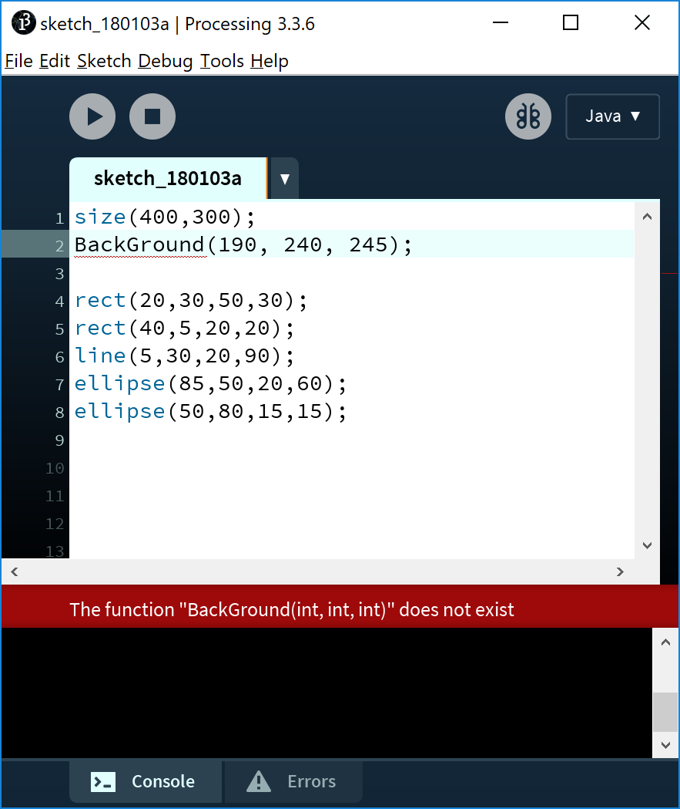
Syntax Errors
The spelling of the background function must be identical to the spelling below (case sensitive!).
background(r, g, b)
r = red colour (a number between 0 and 255 inclusive)
g = green colour (a number between 0 and 255 inclusive)
b = blue colour (a number between 0 and 255 inclusive)

Slide 30

Syntax Errors
The background function has too many arguments passed to it i.e.
RGB version is defined with 3 parameters.
Grayscale version is defined with 1 parameter.
background(r, g, b)
r = red colour (a number between 0 and 255 inclusive)
g = green colour (a number between 0 and 255 inclusive)
b = blue colour (a number between 0 and 255 inclusive)

Slide 31
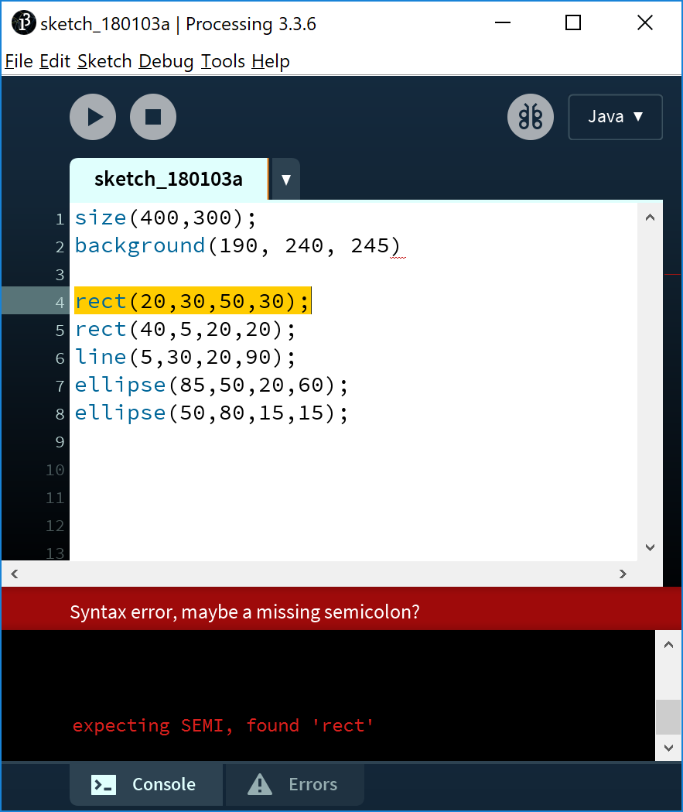
Syntax Errors
The semi-colon (;) is missing at the end of the statement.
Java needs a statement terminator for each line!

Slide 32
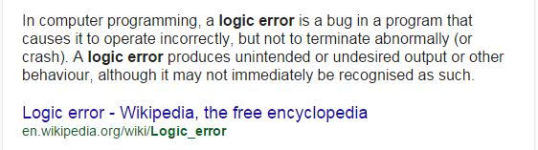
Logic Errors

Slide 33
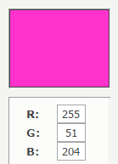
Logic Errors
Say we wanted a pink background for our display window.

Slide 34
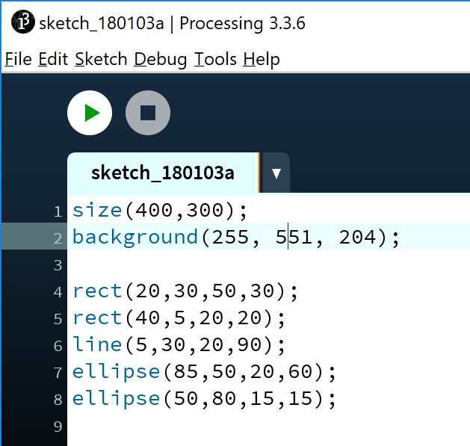
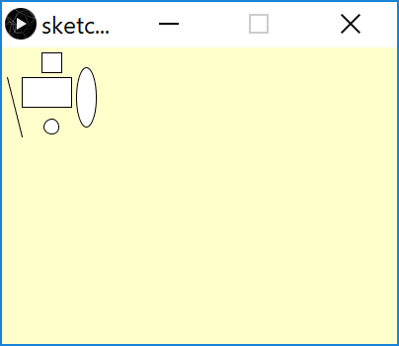
Logic Errors
Say we wanted a pink background for our display window.
However, we incorrectly enter the G colour as 551 instead of 51.
We now have a yellowish background.
This is an example of a simple logic error.

Slide 35
Commenting your Code

Slide 36
Code so far…
Can you tell, from looking at the code, what RGB colours you have chosen?
We can leave notes for ourselves and others in our code.
This is called commenting your code.
Notes:
size(400,300);
background(190, 240, 245);
strokeWeight(3);
fill(100, 150, 70);
rect(100,100,200,100);
rect(150,200,20,20);
line(100,100,300,200);
fill(200,250,70);
noStroke();
ellipse(200,100,20,60);
stroke(0,0,0);
ellipse(250,130,25,25);

Slide 37
Commenting your code…
// This is a comment.
// Anything typed after the two slashes
// up to the end of the line, is ignored by Java.
/* This is a longer comment. As you can span more than one line with this comment style, it can be quite handy. */

Slide 38
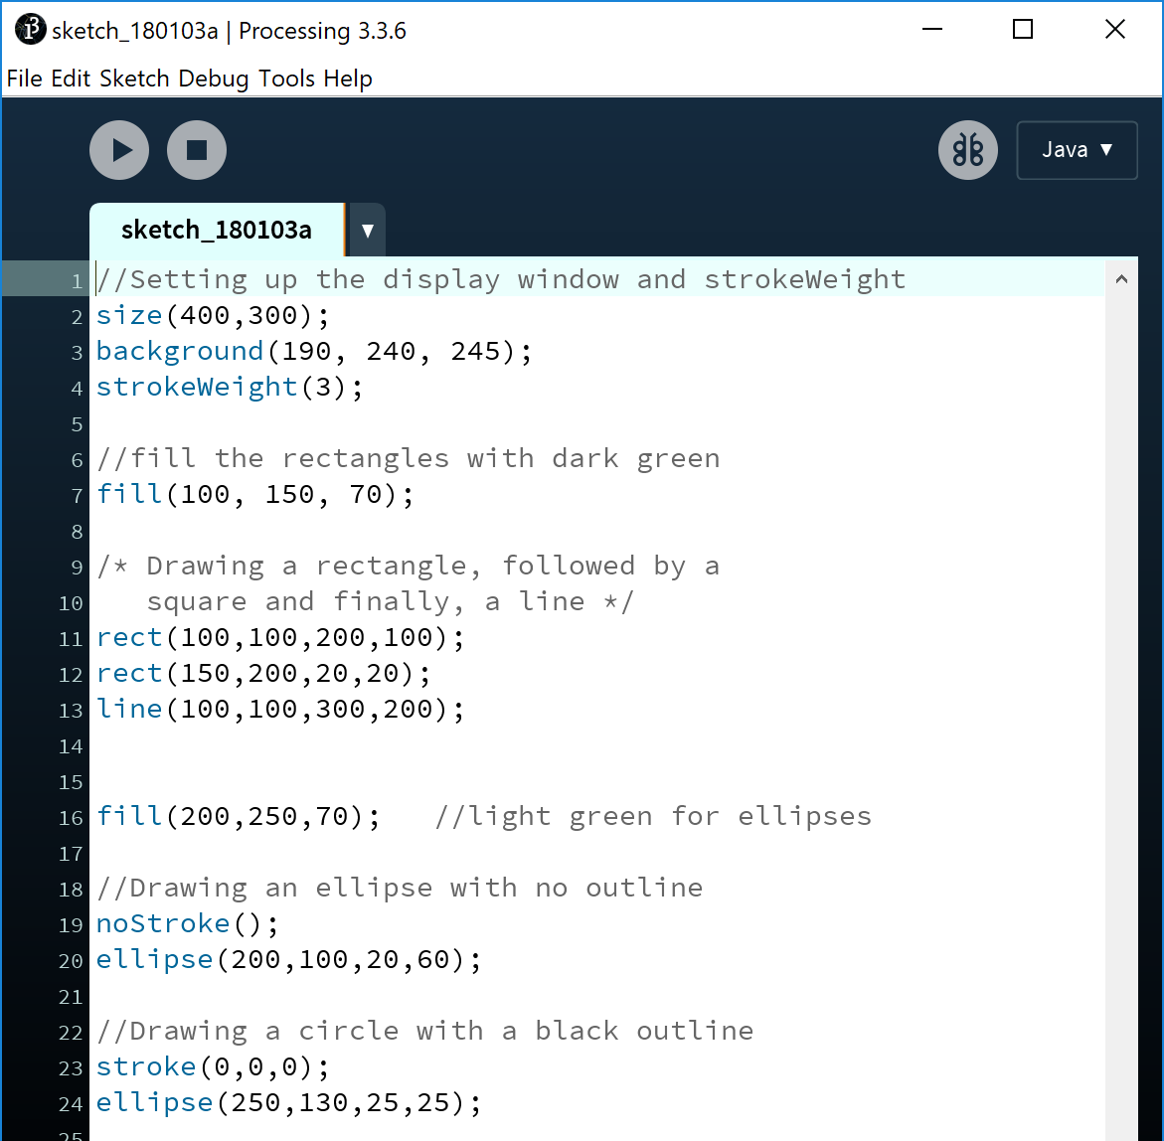
Code so far…with commenting
We have commented our code with explanations of what is happening.
This makes our code easier to read, understand and maintain.
It is considered best practice to comment your code.
Comments do not affect your code at all.
Notes:
//Setting up the display window and strokeWeight
size(400,300);
background(190, 240, 245);
strokeWeight(3);
//fill the rectangles with dark green
fill(100, 150, 70);
/* Drawing a rectangle, followed by a
square and finally, a line */
rect(100,100,200,100);
rect(150,200,20,20);
line(100,100,300,200);
fill(200,250,70); //light green for ellipses
//Drawing an ellipse with no outline
noStroke();
ellipse(200,100,20,60);
//Drawing a circle with a black outline
stroke(0,0,0);
ellipse(250,130,25,25);

Slide 39

Questions?

Slide 40



